Slide 1


Green Pace
Security Policy Presentation
Developer: Tim Gallus

Slide 2

OVERVIEW: DEFENSE IN DEPTH
A defense-in-depth approach to security provides a layered defense providing security from multiple directions of attack and multiple layers, along with mitigating the impact of breaches and providing accounting that helps find issues when breaches occur and respond to them appropriately. Security needs to be proactive rather than an afterthought and needs to be universally and uniformly implemented. A strong security policy is the first step.

Slide 3
THREATS MATRIX
Likely Value returning functions not returning a value from all exit paths. Modifying string literals. Not freeing dynamically allocated memory when no longer needed. Not guaranteeing exception safety. Failure to ensure that unsigned integer operations do not wrap. | Priority Failure to sanitize data passed to complex systems
Low priority Failure to understand the termination behavior of assert() and abort() Using predicate function objects that are mutable. | Unlikely Implementing abstract data types without using opaque types. Modifying standard namespaces.
Our threat matrix lists some of the vulnerability causes associated with our coding standards grouped under whether they are likely or unlikely and whether they are a priority or not. It’s worth noting that the severity of the threat along with the likely cost to mitigate it should it occur also drives if a threat is a high or low priority.

Slide 4
10 PRINCIPLES
Validate Input Data | Validate all input data no matter the source. This is the first line of defense. Keep in mind potential input data sources. Applicable coding standards: STR-004-CPP, INT-009-CPP
Heed Compiler Warnings | Compile code using highest warning level for compiler and eliminate reported warnings by changing the code. Additionally utilize static and dynamic tools to find additional security issues and correct them. Applicable coding standards: STR-003-CPP, DCL-008-CPP
Architect and Design for Security Policies | Always include implementation of security policies as part of design from the start. Applicable coding standards: STR-003-CPP, MEM-005-CPP, DCL-008-CPP, CTR-010-CPP
Keep It Simple | Complex code is not necessarily better code. Keep code to the simplest implementation possible to accomplish the goal. In addition to non-security reasons, the more complicated code becomes the more likely it is to contain or obfuscate security vulnerabilities. Applicable coding standards: MSC-002-CPP, MEM-005-CPP, DCL-008-CPP
Default Deny | Access and permissions should always default to denial rather than defaulting to permitted. Applicable coding standards: DCL-001-CPP
Adhere to the Principle of Least Privilege | Subjects should be given only those privileges that are needed in order to complete a task. Additional permissions should only be given for the duration of the task that requires them. Applicable coding standards: DCL-001-CPP, ERR-006-CPP
Sanitize Data Sent to Other Systems | Sanitize data before sending to other systems to remove unsafe characters. This goes hand in hand with input validation and will minimize available exploits in the event of a breach. Applicable coding standards: STR-004-CPP
Practice Defense in Depth | Always take a defense in depth approach to security by creating multiple security layers. Applicable coding standards: STR-004-CPP, ERR-006-CPP, CTR-010-CPP
Use Effective Quality Assurance Techniques | Good Quality Assurance practices should be employed in order to help in finding and removing vulnerabilities along with other issues. Some of these include Fuzz testing, penetration testing, and code audits. Whenever possible utilize external reviewers to get fresh eyes and opinions. Applicable coding standards: ERR-006-CPP, ERR-007-CPP
Adopt a Secure Coding Standard | Select and adhere to an existing credible coding standard and/or prepare a list of coding guidelines specific for your company.

Slide 5
CODING STANDARDS
Our 10 coding standards are listed below organized by priority. Priority is based on the severity of the related vulnerabilities, the likelihood they will occur, and the remediation cost related to them.
Code Standard | Rule | Severity | Likelihood | Remediation Cost | Priority
Sanitize data passed to complex subsystems | STR-004-CPP | High | Likely | Medium | High
Ensure that unsigned integer operations do not wrap | INT-009-CPP | High | Likely | High | Medium
Guarantee exception safety | ERR-007-CPP | High | Likely | High | Medium
Value-returning functions must return a value from all exit paths | MSC-002-CPP | Medium | Probable | Medium | Medium
Free dynamically allocated memory when no longer needed | MEM-005-CPP | Medium | Probable | Medium | Medium
Do not modify the standard namespaces | DCL-008-CPP | High | Unlikely | Medium | Medium
Understand the termination behavior of assert() and abort() | ERR-006-CPP | Medium | Unlikely | Medium | Low
Do not attempt to modify string literals | STR-003-CPP | Low | Likely | Low | Medium
Predicate function objects should not be mutable | CTR-010-CPP | Low | Likely | High | Low
Implement abstract data types using opaque types | DCL-001-CPP | Low | Unlikely | High | Low

Slide 6
ENCRYPTION POLICIES
Encryption in rest | Encryption at rest is the encryption of stored data that is not in active use. It is typically already secured behind a firewall and general system security. We need to understand the sensitivity of the data to be secured, it should be encrypted appropriately to prevent users without authorization from being able to access and read it. A role-based accounts strategy should be utilized to allow permission to access the encrypted data and it should default to denial. Appropriate authentication security and accounting through logging of account actions are also important.
Encryption at flight | Encryption of data and communications as it is actively being transmitted. Encryption of the data in transit is necessary to defend against potential attacks in transit and verification of the data’s receiver is also important.
Encryption in use | Encryption of data in active use. This data should be obscured when reasonable, such as hashing passwords as they are entered. Access should be restricted utilizing authentication and authentication to make sure only those who should be able use the data or systems can access it.

Slide 7
TRIPLE-A POLICIES
Authentication | Authentication is identifying the user and verifying that they are allowed access to the system. Typically through username, password and multifactor authentication.
Authorization | Authorization is deciding what permissions a legitimate user that has been authenticated should have at any given time. This is usually done through role-based accounts associated with a specific user. In principle permissions should default to denial and be the minimum necessary for the user to accomplish their goal. Furthermore, it is wise to restrict permissions to being granted only for the timeframe during which they are needed.
Accounting | Accounting involves tracking what actions a user takes on the system including what they have accessed, typically through logging. Accounting allows damage due to breaches to be mitigated by letting those investigating see what changes were made and what data may have been accessed.

Slide 8
Unit Testing
Test that a collection is empty when created.
// Test that a collection is empty when created.
TEST_F(CollectionTest, IsEmptyOnCreate)
{
// is the collection empty?
ASSERT_TRUE(collection->empty());
// if empty, the size must be 0
ASSERT_EQ(collection->size(), 0);
}

Slide 9
Unit Testing
Negative Test: Verify reserve throws an exception when reserving greater than max_size.
//Verify reserve throws an exception when reserving greater than max_size.
TEST_F(CollectionTest, ReserveThrowsExceptionIfOverMaxSize)
{
add_entries(5);
//Verify the collection is size 5
ASSERT_EQ(collection->size(), 5);
//Verify an exception is thrown when reserving greater than max_size.
ASSERT_ANY_THROW(collection->reserve(collection->max_size() + 1));
}

Slide 10
Unit Testing
Test to verify resizing decreases the collection
// DONE: Create a test to verify resizing decreases the collection
TEST_F(CollectionTest, CanDecreaseSizeUsingResize)
{
add_entries(5);
//Verify the collection is size 5 after adding entries
ASSERT_EQ(collection->size(), 5);
//Use resize to decrease the size of the collection
collection->resize(3);
//Verify the collection is decreased to size 3 after the resize.
ASSERT_EQ(collection->size(), 3);
}

Slide 11
Unit Testing
Test to verify adding five values to collection
TEST_F(CollectionTest, CanAddFiveValuesToVector)
{
//Verify the collection starts at size 0
ASSERT_EQ(collection->size(), 0);
add_entries(5);
//Verify the collection is size 5 after 5 entries are entered.
ASSERT_EQ(collection->size(), 5);
}

Slide 12
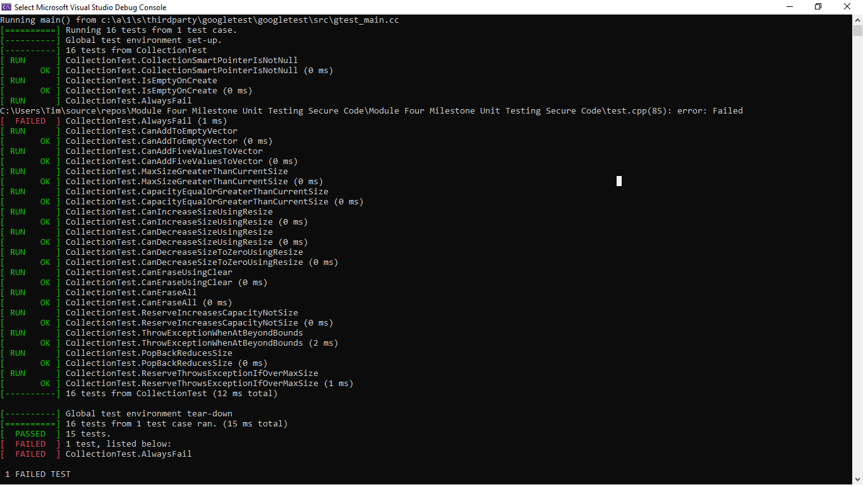
Unit Testing

Slide 13

AUTOMATION SUMMARY

Slide 14
TOOLS
Automated enforcement of the standards encompassed by this policy should happen at code check in, at the interstitial line between design and build. Whenever new code is checked in to a separate branch before it merges to main, it should trigger automated tests to run the various tools listed in the various coding standards that have been set up as part of the check in pipeline for this purpose and raise awareness of any security policy violations. Unit testing should also occur at this point. Code that does not meet the security policy requirements should fail check in compliance until it is fixed. There should also be an automated request triggered on code check in to request a peer review.
Additional automated testing should be included as part of the Verify and Test phase to retest the full build rather than focusing on newly checked in code. Some automated collecting of logs and detection can be added to the Monitor and Detection to watch for violations of these security policies occurring or being exploited.

Slide 15
RISKS AND BENEFITS
Implementing a defense in depth security strategy proactively based on a uniform and reliable security policy can drastically reduce vulnerability to security breaches and costly mitigation and retrofitting of code design and implementation to secure vulnerabilities after the fact. The primary costs of doing so are additional time to plan and design with security and defense in depth in mind from the start and the additional training to make sure everyone at the company is aware and practicing the chosen security policy and other good security practices. However, waiting until after during or after code implementation to implement security, or not having a unified security policy can lead to costly code redesigns during or after implementation along with unexpected vulnerabilities being left in place. Both of which can be much more costly in the long run.

Slide 16
RECOMMENDATIONS
The current security policy is an initial base that has areas where it could use additional improvement and elaboration. These include:
User security training. Poor password security, unattended work devices that may be accessed by malicious parties, and vulnerability of the human element to social engineering attacks is one of the more difficult vulnerabilities to fully secure. Our policies did not cover this strongly, but the company should put strong policies and training in place for everyone with regards to these.
Penetration and other “white hat hacker” security testing for security vulnerabilities. Regular and knowledgeable testing may find allow security vulnerabilities to be closed before they come to the awareness of malicious parties.
Nothing in our policies discussed physical security of hardware assets or the need to use reputable cloud assets that are suitably secure.
Our current security policies do not go in depth about the steps we will take to provide accounting beyond going into its importance.

Slide 17
CONCLUSIONS
It is important moving forward to keep the tools and software that we use up to date, to remain aware of new and existing security threats, to be proactive in our security planning rather than seeing security as an afterthought to development. Educating ourselves and others on the security policies of the company and making sure we select security policies that are best for our industry is important and just like security practices, security threats are always evolving. While constant change to our policies is not helpful, we should review our security policies at appropriate intervals or when new threats develop and adjust them to meet the changing needs.
As individuals we should stay aware of the security policies of this company and general best security practices and actively make use of them.

Slide 18
REFERENCES

